Slide 1

INSURANCE ANALYTICS
Project- P1075
Project Mentor​

Slide 2
Meet Our Teammates
Ms.Sinchana M
Ms.R Bhavani Kudthe
Mr.Sahil Rajendra Mandare
Ms.Sanika Sainath Chaudhari
Ms.Shaik Saleha begum
Mr.Kottu Jithendra
Mr.Velakanti Ajaykumar

Slide 3

Weekly Performance Review – Ahmedabad Branch
Domain : Insurance Analytics
Tools & Modules Used:
1.MS Excel
2.Power BI
3.MySQL
4.Tableau

Slide 4
AGENDA
1
2
3
4
5
Introduction
Data Collection & Cleaning
Key KPIs Identification
Dashboard & Visualization
Conclusion & Recommendation

Slide 5
INTRODUCTION
The project analyzes the performance of Account Executives in the Ahmedabad branch using Excel, Power BI, MySQL and Tableau.
Performance is evaluated across Placed and Invoiced categories, further segmented into New, Cross-Sell, and Renewal.
Achievement percentages are calculated to measure target vs actual performance.
Key KPIs include yearly meeting count, total meetings, policy-wise performance, invoices raised, open opportunities, and overall productivity.
The insights enable clear performance tracking, support data-driven decisions, and improve operational effectiveness.

Slide 6





DATASET DESCRIPTION
Brokerage
Contains detailed information about client policies, including policy type, income generated, and renewal status.
Fees
Includes data related to client income transactions, covering revenue details, transaction amounts, and types.
Budget
Provides budget allocations for branches and employees, covering new business roles, cross-sell targets, and renewal plans.
Invoice
Stores details of all generated invoices, including transaction amounts, invoice types, and linked client information.
Meeting
Tracks meetings conducted by account executives, capturing branch details, attendees, and meeting type.

Slide 7

KPI Analysis
No. of Invoice by Account Exec
Cross Sell
Yearly Meeting Count
Target,
Achieved,
new
New
KPI’s
Renewal
Top Open Opportunity
No. of meeting By Account Exec

Slide 8
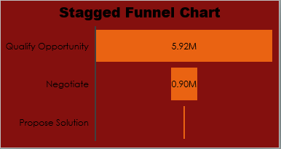
KPI’s

Slide 9
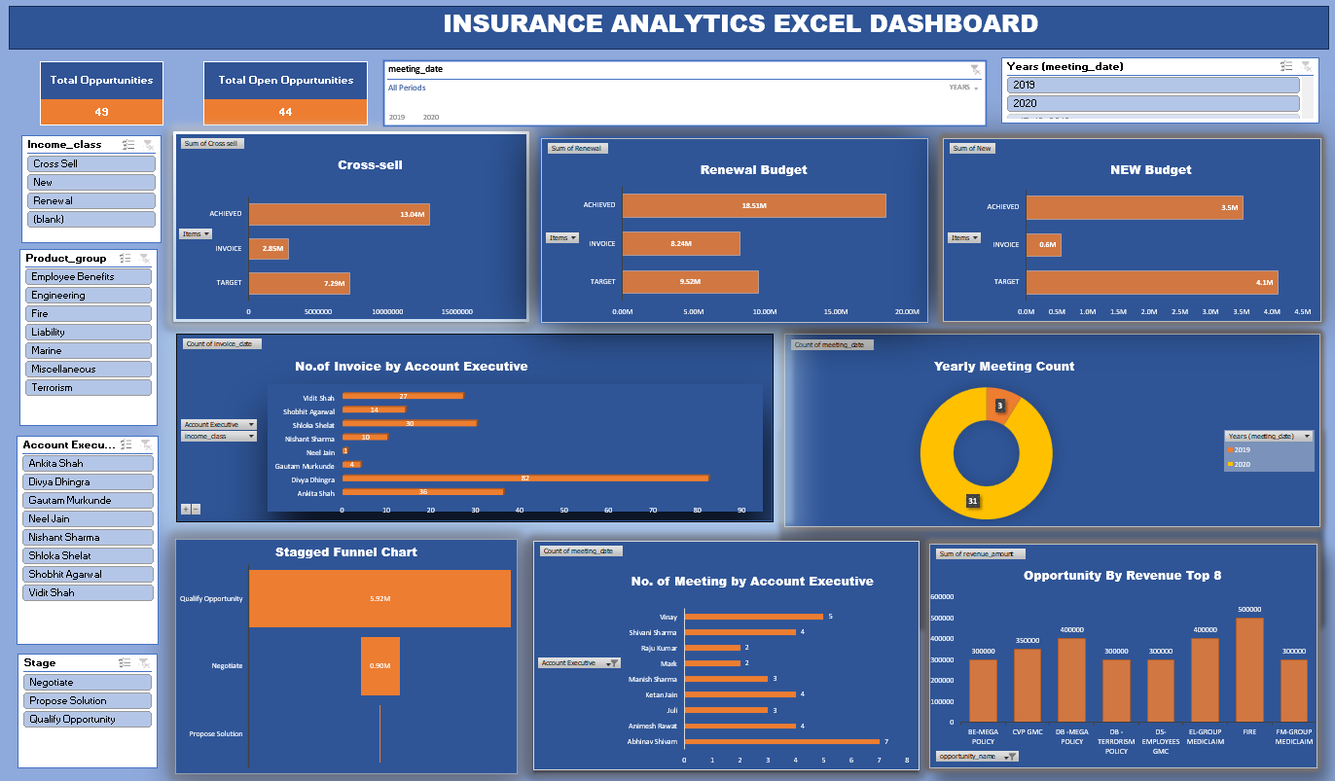
Excel Dashboard

Slide 10
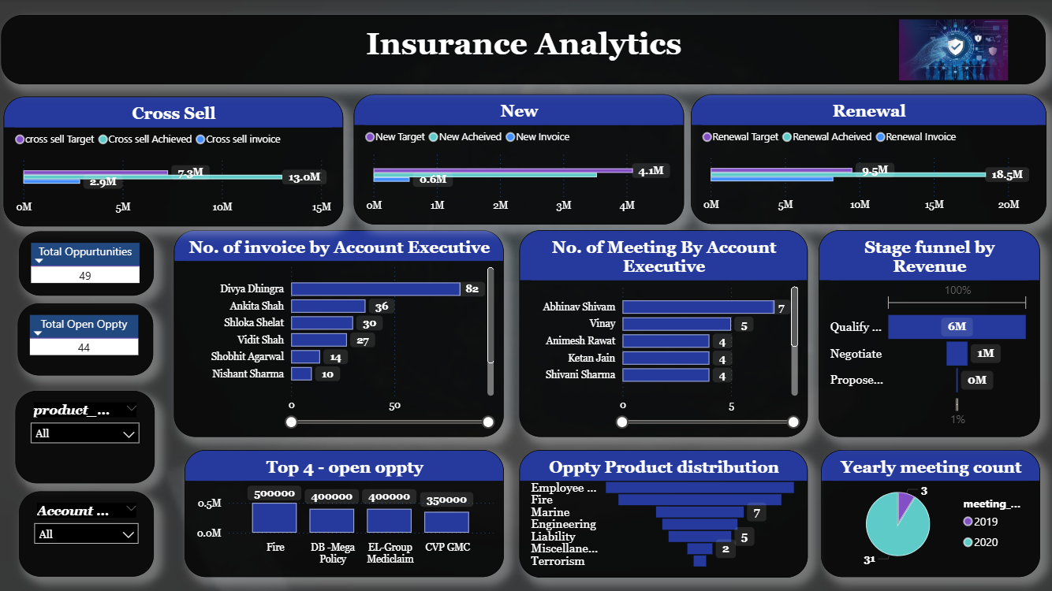
Power BI Dashboard

Slide 11
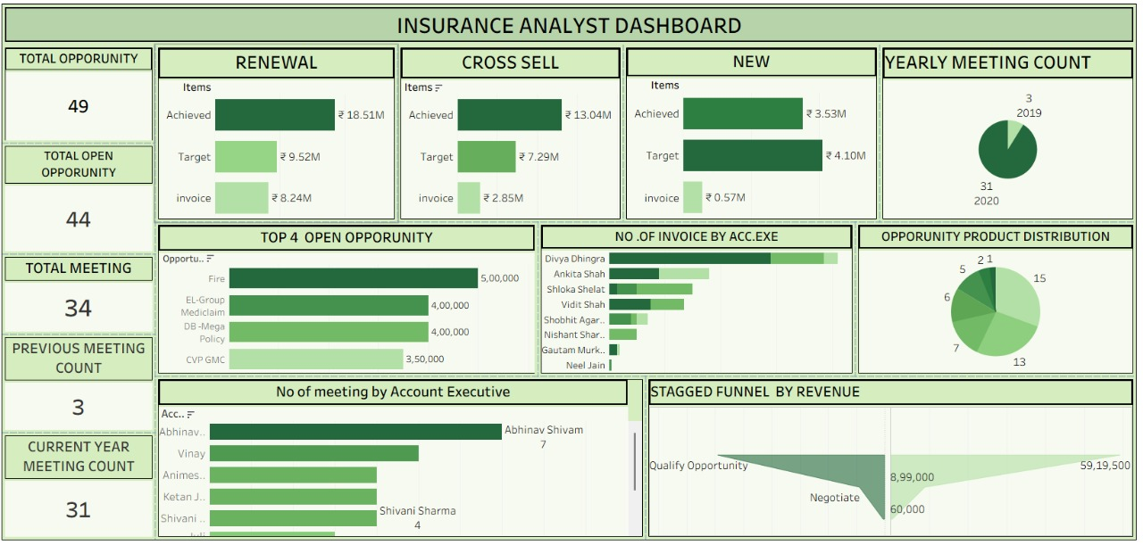
Tableau Dashboard

Slide 12
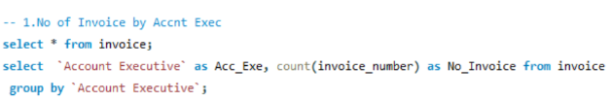
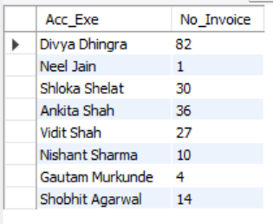
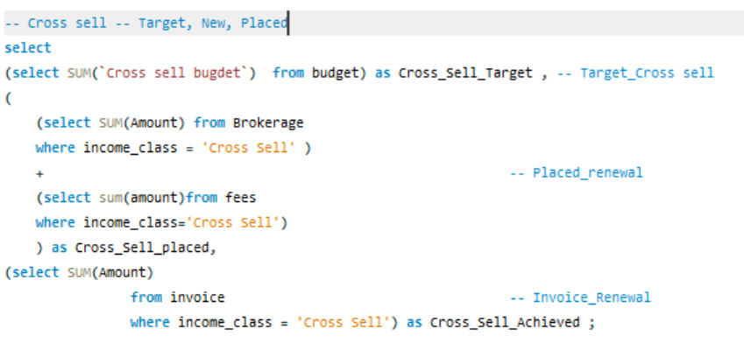
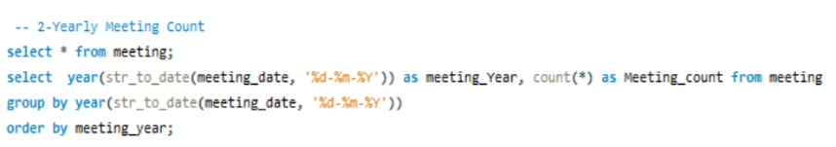


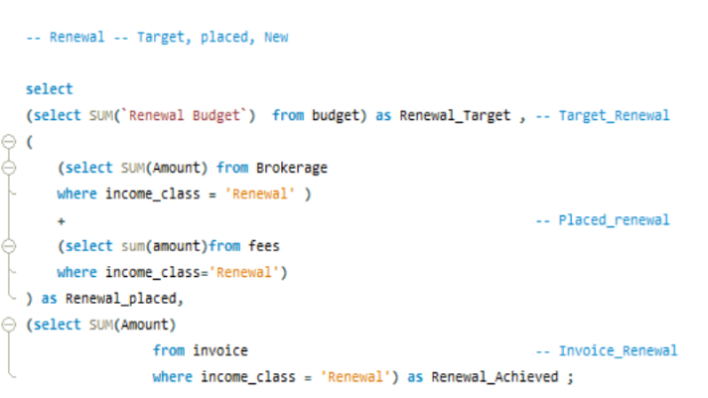

MySQL Queries

Slide 13
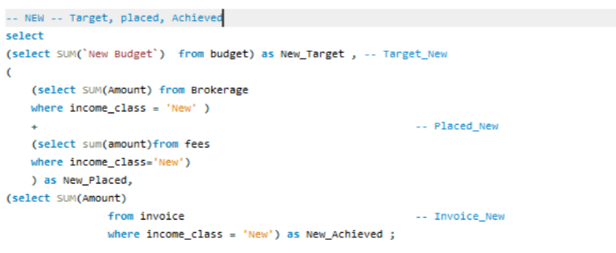

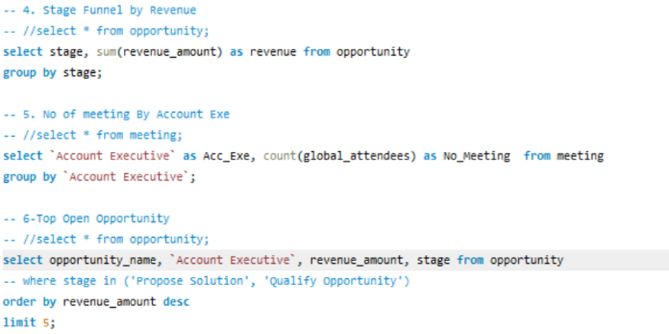
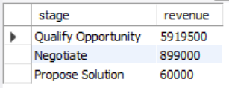
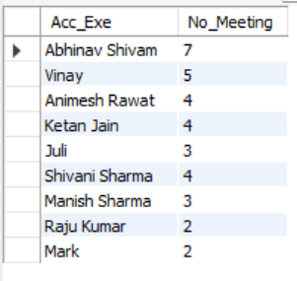
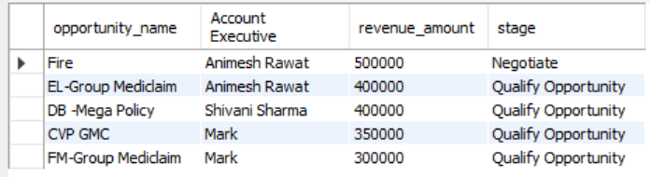
MySQL Queries

Slide 14
Conclusion
Renewal Policies are the top performer with the highest profitability and growth, reflecting strong customer retention.
Cross-Sell Policies generate high margins with consistent growth, making them a key revenue driver.
New Policies show stable returns but lower growth, indicating the need for stronger acquisition strategies.
Business Focus: Prioritize renewals and cross-selling while improving new customer acquisition for sustainable growth.

Slide 15
Maximize Renewals: Strengthen proactive renewal reminders and personalized engagement to sustain high profitability.
Accelerate Cross-Selling: Use customer insights to deliver targeted offers and increase wallet share.
Boost New Policy Growth: Apply data-driven segmentation and focused marketing to improve acquisition.
Enhance Customer Experience: Implement AI-enabled support for faster service and higher satisfaction.
Optimize Operations: Upskill teams and leverage automation to improve efficiency and reduce costs.
Recommendation
“
”

Slide 16

Thank you

